Slide 1
Speed Tracker
By: Zhill Patel

Slide 2
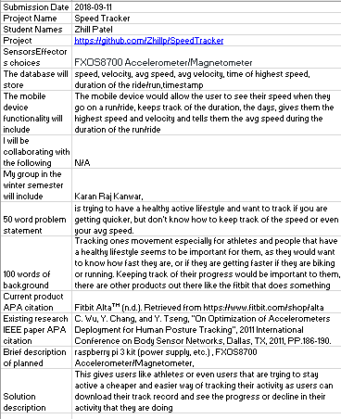
Proposal

Slide 3
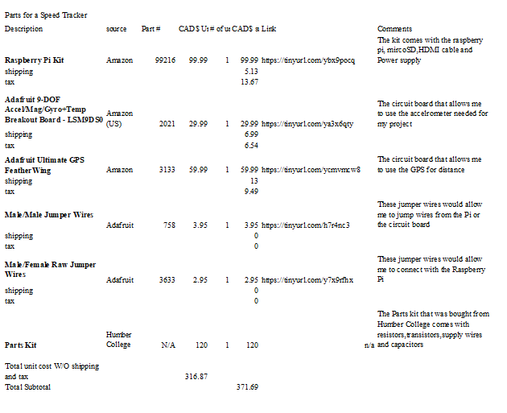
Budget

Slide 4
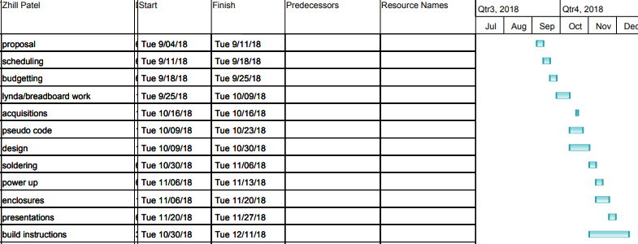
Schedule

Slide 5
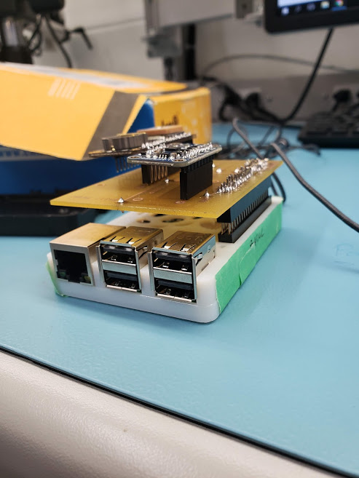
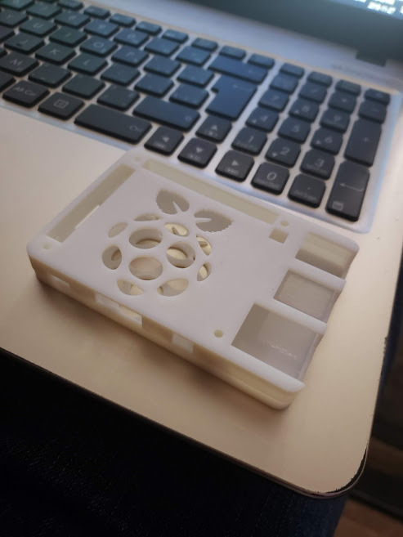
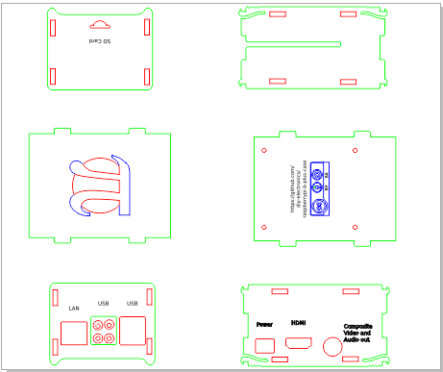
Cases

Slide 6
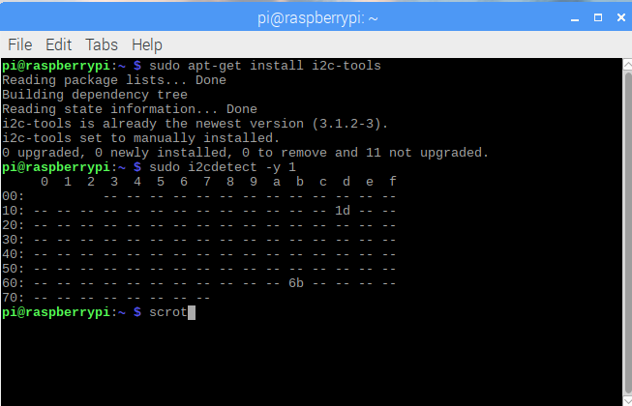
I2C Address

Slide 7
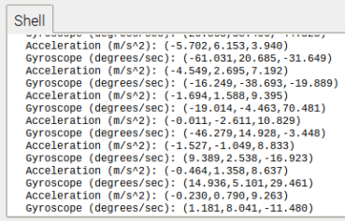
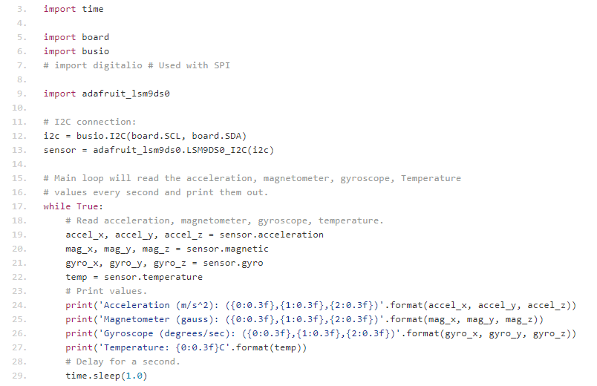
Reading/Writing

Slide 8
Course Knowledge
Electronic Circuits
Breadboarding
Embedded Systems
Working with the raspberry Pi
Intro to Software Engineering
Gantt chart and scheduling
Technical Writing - Writ220
Proposal

